Slide 1

Roborally Demo
FELLOWSHIP-OF-THE-INF

Slide 2

Technical knowledge gained
Google, Stackoverflow
LibGDX, Tiled, Maven
Git: branches, merging, project board, releases
Automated Code Review, Codacy
Manual Testing
Userstories

Slide 3

Oragnizational
The importance of good communication
XP worked very well
  Iterations
  Prioretized list of requirements in iteration
  Pair-programming
  Continuous code review
  Reflections on previous iteration
Well-defined roles
Consistent meetings

Slide 4

Communication
It is in fact very difficult to keep everyone informed
Everyone doesn’t need to know everything
Formulation is important, miscommunication happens easily
Well-written commit messages

Slide 5

Closing of the universiTy
Initially this slowed our progress
Bad internet connection -> inefficient meetings
After a while Digital meetings became more effective than physical meetings
Discord livesteam worked pretty well
Multiplayer over LAN was not possible - AI
Communication with group leaders improved after a while

Slide 6

What we’d do differently next time
More thorough planning
Use effective working practices earlier:
  Pair-programming
  Role distribution
  Codacy
  Reflections on previous work
  proper userstories
  Better abstraction (Rules, Cleanup, Grid + Game Map)
Better use of Project board, issue tracking system

Slide 7
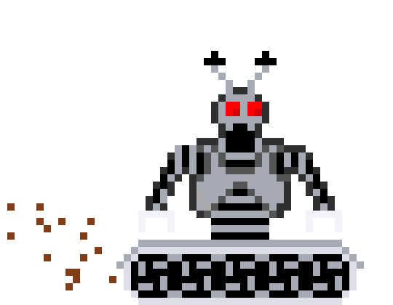
Further work on Roborally
Human vs Human multiplayer
Bugfix
Better abstraction
Improve runtime
Option cards
Better UI
Generally better graphics
Rotation of the board

Slide 8
DEMO
Without music and sound effects :(

